Slide 1

Inflationary Effects
AI Boot Camp Project 1
https://github.com/jbgraham073/ai_group_project_1.git
https://www.natureaustralia.org.au/what-we-do/our-priorities/wildlife/wildlife-stories/meet-the-quokka/
Quokka - the perpetually smiling, pocket-sized ambassador of happiness hopping around Australia's shores, spreading joy wherever it goes! 🦘😊
Team Members: Seneca Moore, Bab Jan, Bo Kimball, Adam Millington, JB Graham

Slide 2
Project Overview
Project Purpose / Description
Our objective is to identify primary drivers of inflation within the United States economy. Subsequently, we aim to analyze the repercussions of inflation on various socio-economic factors such as crime rates, unemployment levels, and mental health.
To achieve this, we employed data visualizations, correlations, lagged correlations, and prophet model forecasting.
Our datasets consist of time series comprising daily, monthly, quarterly, and annual data spanning either the past decade or two decades.

Slide 3
Project Overview
Goals/Questions to be addressed
What economic factors have the strongest correlation with inflation?
How does inflation impact social behaviors such as mental health, substance abuse, and crime?
Based on this retrospective analysis what do we predict to happen with inflation in the next two years?
Post Project Data Analytics Scope.

Slide 4
Project Overview
Approach taken to achieve goals
Data Collection
Data Cleaning
Casting different time periods
Exploration
Correlation Tables
Heat Maps
Bar Charts
Forecast Inflation with Prophet
Project Management
Asana

Slide 5
Project Overview
Overview of data collection, cleanup and exploration process
Sources
FRED (Federal Reserve Economic Data) - Economic
SAMHSA (Substance Abuse and Mental Health Services Administration) - Mental Health
FBI (Federal Bureau of Investigation) - Crime
Varying Reporting Frequencies
Monthly
Quarterly
Yearly
Cast Monthly on to Quarterly, Quarterly on to Yearly from 2000 - 2023

Slide 6
Overview of data collection, cleanup and exploration process
DataSet FileName | Description | Variables | Frequency | Start | End | Links
fed_current_tax_receipts | Quarterly dataset showing the federal tax income. | Federal tax Receipts | quarterly | 01/01/2000 | 07/01/2023 | https://fred.stlouisfed.org/series/W006RC1Q027SBEA
fed_surplus_deficit | Monthly data overview of the federal budget surplus or deficit. | Federal Surplus/Deficit | monthly | 01/01/2000 | 12/01/2023 | https://fred.stlouisfed.org/series/MTSDS133FMS
mh_sa | Annual mental health data describing diagnoses of anxiety, depression, and substance abuse. | Anxiety, Depressive disorder, Alcohol/substance use | annual | 2013 | 2021 | https://www.samhsa.gov/data/data-we-collect/mh-cld-mental-health-client-level-data
consumer_price_index | Median Consumer Price Index (CPI) is a measure of core inflation calculated the Federal Reserve Bank of Cleveland and the Ohio State University. | Inflation | monthly | 2000 | 2023 | https://fred.stlouisfed.org/series/MEDCPIM158SFRBCLE
crime_rates | Yearly overview of crime rates for different types of crime. | Crime rate | annual | 2000 | 2022 | https://cde.ucr.cjis.gov/LATEST/webapp/#/pages/explorer/crime/crime-trend
data_master_file |  | Interest rate | monthly | 01/01/2000 | 12/01/2023
federal_funds_effective | The federal funds rate is the central interest rate in the U.S. financial market. | Federal Funds Rate | daily | 2000 | 2023 | https://fred.stlouisfed.org/series/FEDFUNDS
foreign_direct_investment | Quarterly data of Foreign Direct Investments | Foreign Direct Investment | quarterly | 01/01/2000 | 07/01/2023 | https://fred.stlouisfed.org/series/ROWFDIQ027S
unemployment_rate | The unemployment rate represents the number of unemployed as a percentage of the labor force. | Unemployment | monthly | 2000 | 2023 | https://fred.stlouisfed.org/series/UNRATE

Slide 7
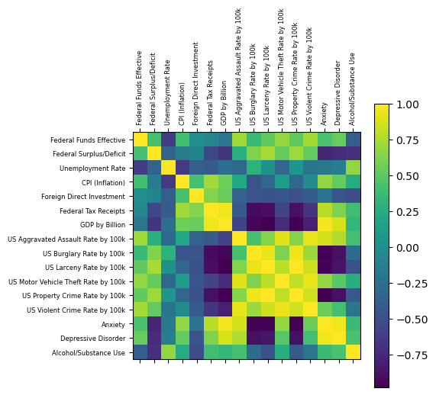
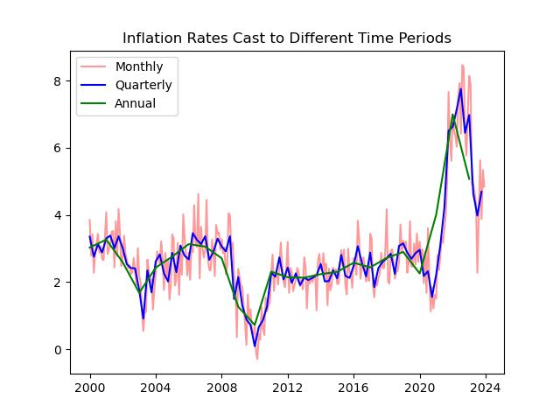
Overview of data collection, cleanup and exploration process
Cleaning Data to Work Together
Correlation HeatMap for All Variables

Slide 8
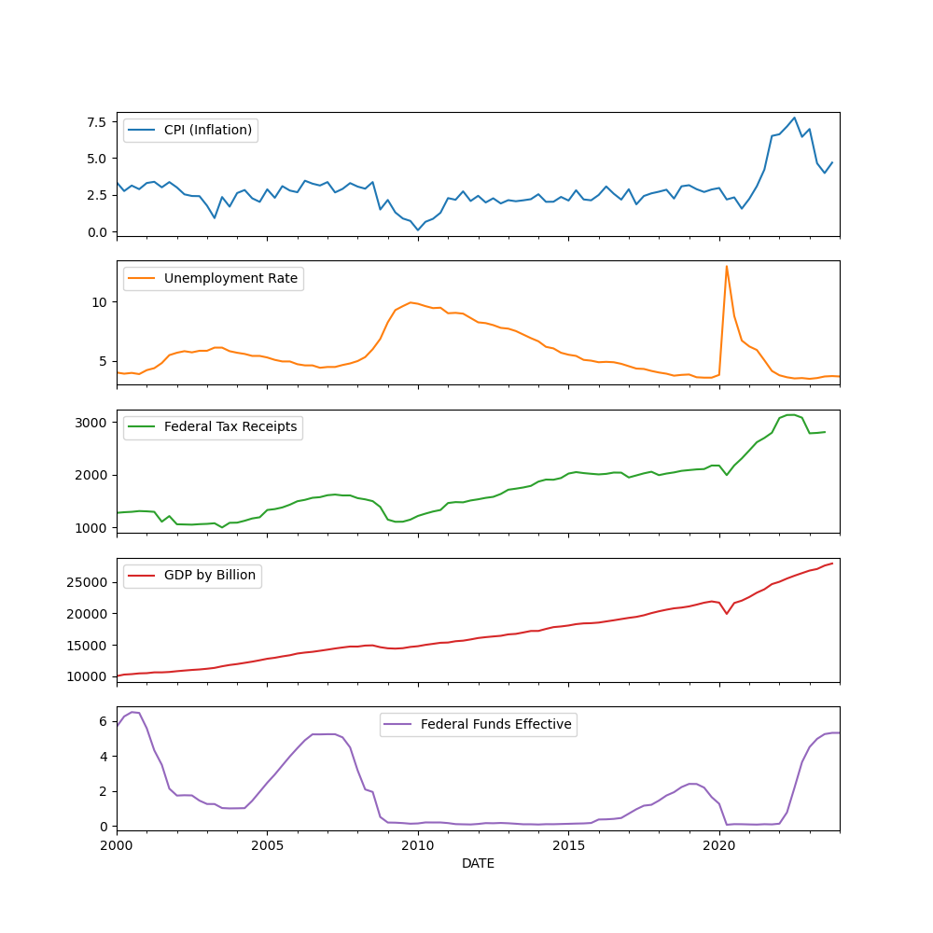
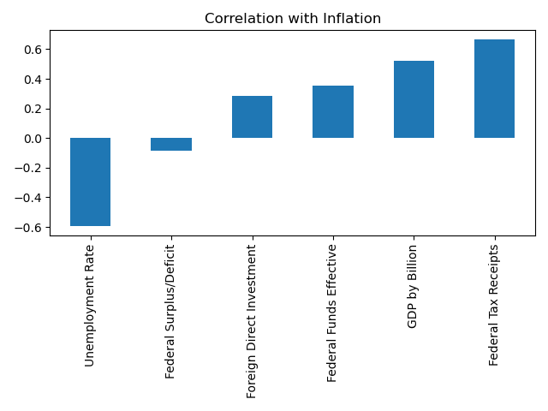
Result/Conclusion 1
Question: What Macroeconomic Factors have the strongest correlation with inflation?

Slide 9
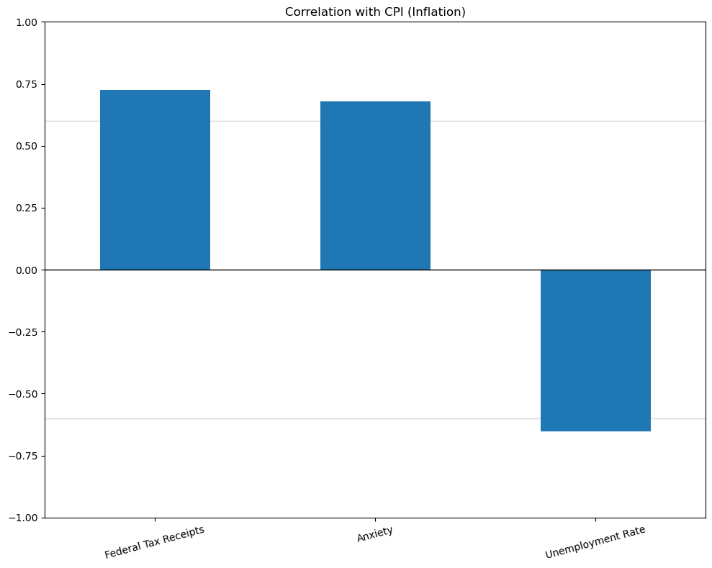
Result/Conclusion 1 cont.
Question: What Macroeconomic Factors have the strongest correlation with inflation?
CPI (inflation) | Federal Tax Receipts | 0.72
 | Anxiety | 0.67
 | Unemployment Rate | -0.65
As inflation rose, so did taxes and anxiety; unemployment decreased as inflation increased. However, with only 3 strong correlations out of our entire set of data with 16 variables, we don't have enough of the right and most meaningful data sources to infer a holistic picture of what indicators correlate with or cause changes in CPI.

Slide 10
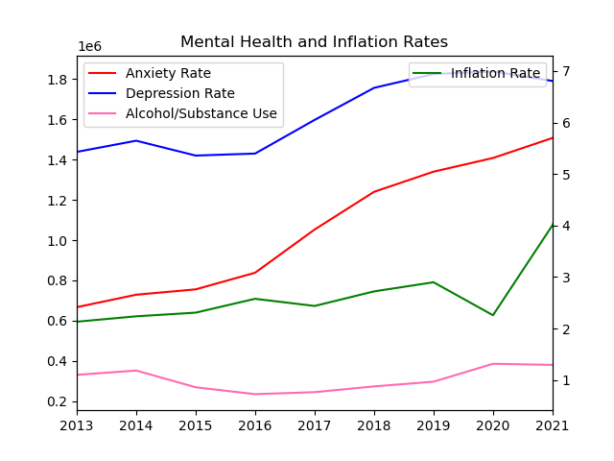
Result/Conclusion 2
Question: How does inflation impact social behaviors such as mental health, substance abuse, and crime?

Slide 11
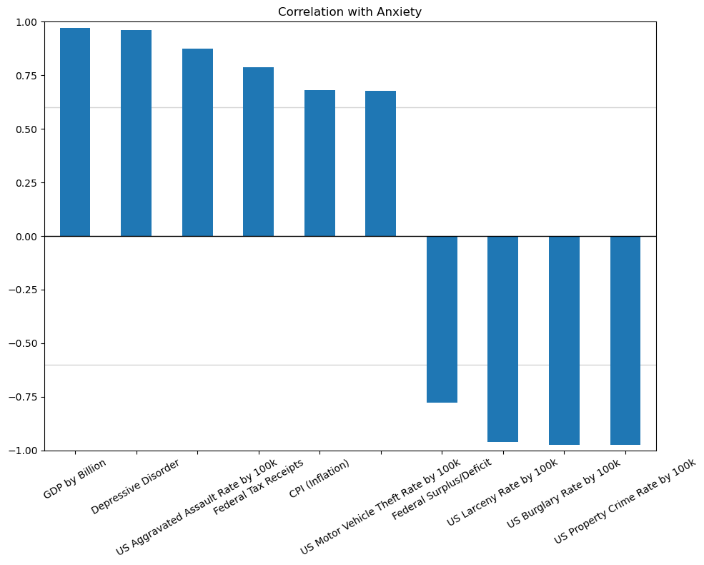
Result/Conclusion 2 cont.
Question: How does inflation impact social behaviors such as mental health, substance abuse, and crime?
Anxiety had strong correlations with 10 out of the 16 variables, from all 3 categories of economy, crime, and mental health. When anxiety was increased, so was inflation, GDP, taxes, and the federal deficit, as well as depression. The crime rate variables of interest decreased when anxiety was increasing.
Anxiety | GDP by Billion | 0.97
 | Depressive Disorder | 0.96
 | US Aggravated Assault Rate by 100k | 0.87
 | Federal Tax Receipts | 0.79
 | CPI (Inflation) | 0.68
 | US Motor Vehicle Theft Rate by 100k | 0.68
 | Federal Surplus/Deficit | -0.78
 | US Larceny Rate by 100k | -0.96
 | US Burglary Rate by 100k | -0.97
 | US Property Crime Rate by 100k | -0.98

Slide 12
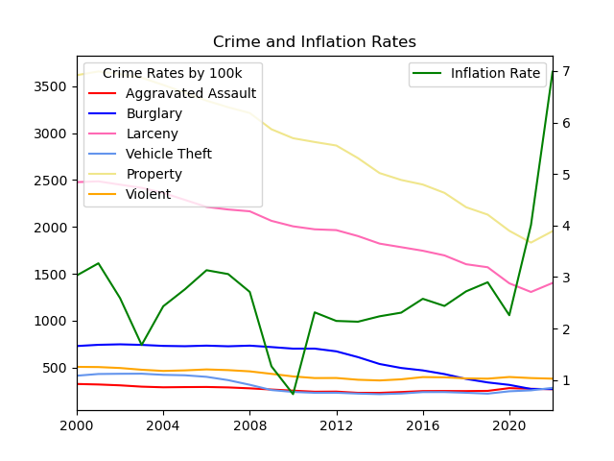
Result/Conclusion 2 cont.
Question: How does inflation impact social behaviors such as mental health, substance abuse, and crime?
Inflation seems to be independent from the crime rate data we gathered, with little to no correlation on crime rates. In this graph you can see that Inflation is somewhat volatile while crime rates are consistently decreasing from the beginning of our dataset’s time frame. (2000 - 2022)

Slide 13
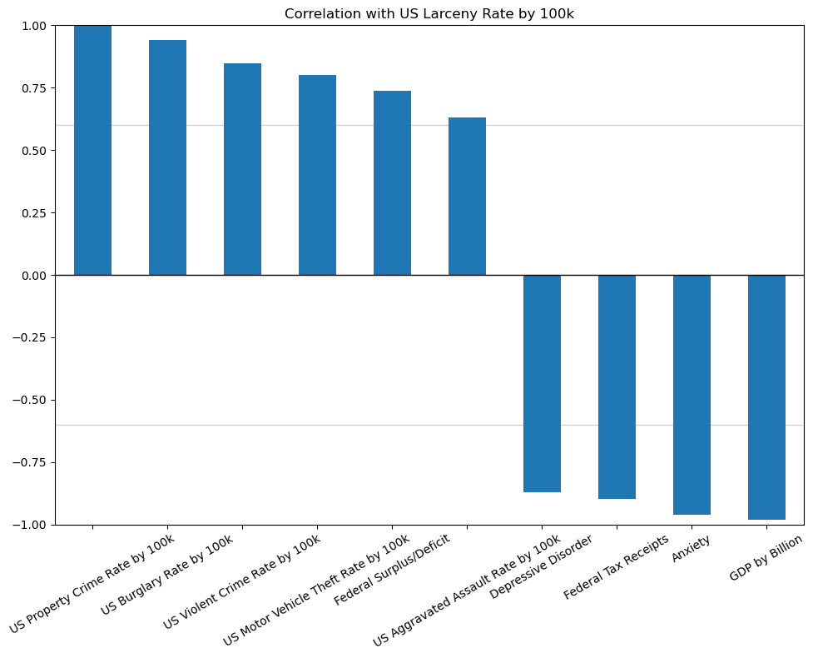
Result/Conclusion 2 cont.
Question: How does inflation impact social behaviors such as mental health, substance abuse, and crime?
Larceny had strong correlations with 10 of the 16 variables, from all 3 categories of economy, crime, and mental health. When larceny was increased, so was property crime, burglary, violent crime, vehicle theft, federal surplus/deficit, and aggravated assault. Depressive disorder, Federal tax receipts, anxiety and GDP exhibited inverse correlation
US Larceny Rate | Property Crime | 0.99
 | Burglary | 0.94
 | Violent Crime | 0.85
 | Vehicle Theft | 0.80
 | Federal Surplus/Deficit | 0.74
 | Aggravated Assault | 0.63
 | Depressive Disorder | -0.87
 | Federal Tax Receipts | -0.90
 | Anxiety | -0.96
 | GDP | -0.98

Slide 14
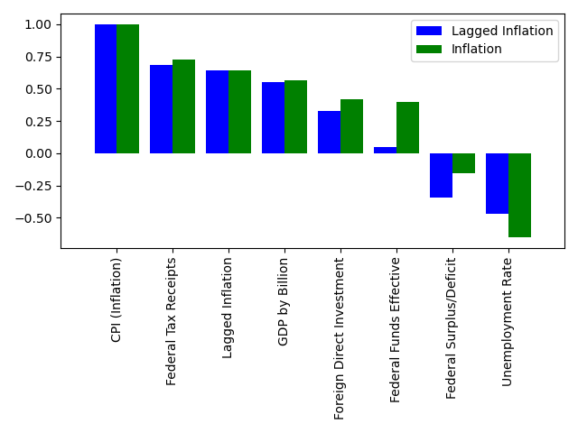
Result/Conclusion 3
Question: Based on this retrospective analysis what do we predict to happen with inflation in the next two years?
During the course of our data analysis we had a hypothesis that some of the variables would have a reactive correlation to the inflation rate. We offset Inflation by a year to illustrate this hypothesis. The meaningful change noted is in the federal surplus/deficit.

Slide 15
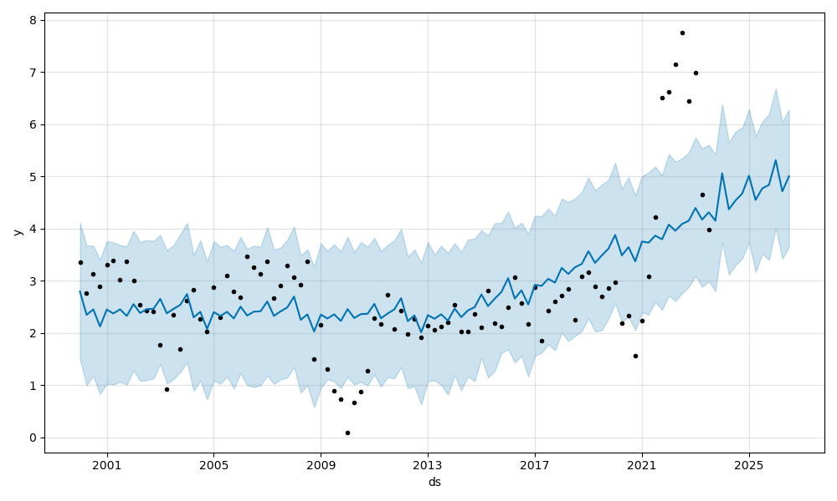
Result/Conclusion 3
Question: Based on this retrospective analysis what do we predict to happen with inflation in the next two years?
Based on the past data we gathered for inflation and utilizing Prophet, we are predicting inflation to continue to rise well into the coming years (2024-2026)

Slide 16
First Take away: Testing Fed’s Monetary Policy Effectiveness
Our original objective was to identify primary drivers of inflation within the United States economy. To examine this objective, we made a guess what economic factors might impact inflation, and also what social factors inflation might impact in the United States.
We did not find as many strong correlations of various economic variables with inflation as we had expected. There were only 3 total strong correlations with inflation out of 16 (tax income, unemployment (-), and anxiety.
Based on our analysis, we do however predict that inflation will continue to rise over the next 2 years.
Anxiety and larceny had more strong correlations than any other variable with the data sources we used, each with 10 out of the 16 variables resulting in strong correlations, from all 3 categories of economy, crime, and mental health.
It’s recommended to have more macro-economic variables and run it through a multiple regression model using Machine Learning skills to detect the key determinants of inflation for the effective monetary policy.
Summary
Second Take away: Social Impact of Inflation
Future Research Scope for the Analytics:

Slide 17
Github
branching
Data Sets
Mismatched Time Periods
Missing Indices
Efficacy of Model
Initial hypothesis not apparent in data collected
Potentially due to constraints of data
External shocks, residual factors not tracked in data (Covid)
Limited subject matter expertise
Time Constraints
Problems Encountered

Slide 18
Summarize any additional questions that surfaced, what your group might research next if more time was available, or share a plan for future development.
We would have liked to have run multiple regression statistical analysis to run but we lacked time.
If time allowed we would have liked to find other sources of longitudinal, large scale mental health data.
We would have liked to examine other phenomena that likely impacted inflation such as political and global events.
Adding a hypothesis and null hypothesis and doing a full statistical analysis evaluating these would have yielded a stronger analysis.
It’s recommended to have more macro-economic variables and run it through a multiple regression model using Machine Learning skills to detect the key determinants of inflation for the effective monetary policy.
Future Considerations

